Slide 1
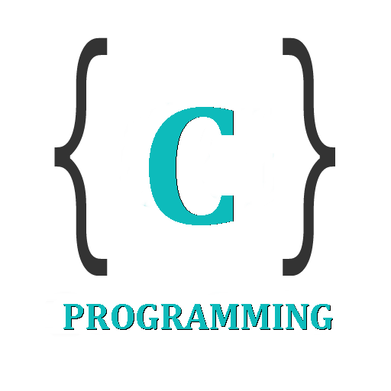

IT 105: Introduction to Programming
Dr. Manish Khare
Dr. Saurabh Tiwari
Lecture 15,16

Slide 2
Pointers in C
In c programming language, we use normal variables to store user data values. When we declare a variable, the compiler allocates required memory with specified name.
In c programming language, every variable has name, datatype, value, storage class, and address.
We use a special type of variable called pointer to store the address of another variable with same datatype.

Slide 3
Pointer is defined as follows...
  Pointer is a special type of variable used to store the memory location address of a variable.
In c programming language, we can create pointer variables of any datatype. Every pointer stores the address of variable with same datatype only. That means, integer pointer is used store the address of integer variable only.

Slide 4
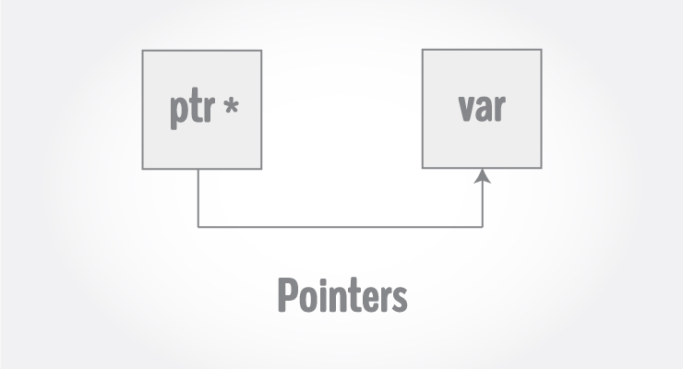

Slide 5
Address Operation
There are two unary operations to consider.
  The * operator: If ptra is a pointer variable, then ∗ptra gives you the content of the location pointed to by ptr.
  The & operator: If v is a variable, then &v is the address of the variable.

Slide 6

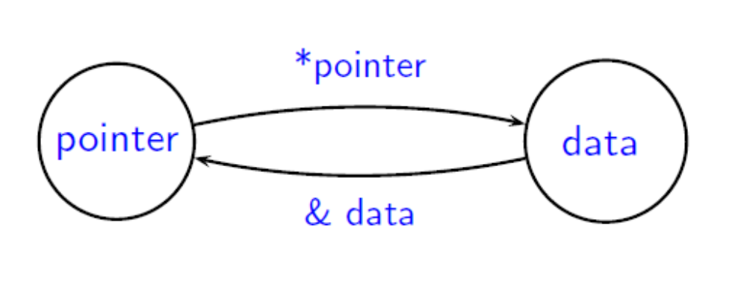

Slide 7
Accessing the Address of Variables
In c programming language, we use the reference operator "&" to access the address of variable. For example, to access the address of a variable "marks“. we use "&marks".
We use the following printf statement to display memory location address of variable "marks"...
  printf("Address : %u", &marks);

Slide 8
/* Example to demonstrate use of reference operator in C programming. */
#include <stdio.h>
int main()
{
int var = 5;
printf("Value: %d\n", var);
printf("Address: %u", &var); //Notice, the ampersand(&) before var.
return 0;
}
Output
Value: 5
Address: 2686778

Slide 9
Note: You may obtain different value of address while using this code.
In above source code, value 5 is stored in the memory location 2686778. var is just the name given to that location.

Slide 10
Declaring Pointers (Creating Pointers)
In c programming language, declaration of pointer variable is similar to the creation of normal variable but the name is prefixed with * symbol.
We use the following syntax to declare a pointer variable...
  datatype *pointerName ;
A variable declaration prefixed with * symbol becomes a pointer variable.
  int *ptr;
In the above example declaration, the variable "ptr" is a pointer variable that can be used to store any integer variable address.

Slide 11
Assigning Address to Pointer
To assign address to a pointer variable we use assignment operator with the following syntax...
  pointerVariableName = & variableName ;
For example, consider the following variables declaration...
  int a, *ptr ;
In the above declaration, variable "a" is a normal integer variable and variable "ptr" is an integer pointer variable. If we want to assign the address of variable "a" to pointer variable "ptr" we use the following statement...
  ptr = &a ;
In the above statement, the address of variable "a" is assigned to pointer variable "ptr". Here we say that pointer variable ptr is pointing to variable a.

Slide 12
int *p;
Declaring a pointer
Assigning value to pointer
int *p;
int j = 25;
p = &j;
data type of pointer
name of the pointer variable
recognize that p is pointer
(space doesn’t matter, position does)
p = &j;
address-of operator

Slide 13
Reference operator (&) and Dereference operator (*)
As discussed, & is called reference operator. It gives you the address of a variable.
Likewise, there is another operator that gets you the value from the address, it is called a dereference operator (*).
Below example clearly demonstrates the use of pointers, reference operator and dereference operator.

Slide 14
Accessing Variable Value Using Pointer
Pointer variables are used to store the address of other variables. We can use this address to access the value of the variable through its pointer.
We use the symbol "*" infront of pointer variable name to access the value of variable to which the pointer is pointing.
We use the following general syntax...
  *pointerVariableName

Slide 15
/* Source code to demonstrate, handling of pointers in C program */
#include <stdio.h>
int main(){
int* pc;
int c;
c=22;
printf("Address of c:%u\n",&c);
printf("Value of c:%d\n\n",c);
pc=&c;
printf("Address of pointer pc:%u\n",pc);
printf("Content of pointer pc:%d\n\n",*pc);
c=11;
printf("Address of pointer pc:%u\n",pc);
printf("Content of pointer pc:%d\n\n",*pc);
*pc=2;
printf("Address of c:%u\n",&c);
printf("Value of c:%d\n\n",c);
return 0;
}

Slide 16
Address of c: 2686784
Value of c: 22
Address of pointer pc: 2686784
Content of pointer pc: 22
Address of pointer pc: 2686784
Content of pointer pc: 11
Address of c: 2686784
Value of c: 2

Slide 17
Common mistakes when working with pointers
Suppose, you want pointer pc to point to the address of c. Then,
  int c, *pc;
  pc = c; // Wrong! pc is address whereas, c is not an address.
  *pc = c; // Correct! *pc is the value pointed by address and, c is also a value.
  *pc = &c; // Wrong! *pc is the value pointed by address whereas, c is an address.
  pc = &c; // Correct! pc is an address and, c is also an address.

Slide 18
Size of basic data types
All data is stored in memory. But different data types occupy different amount of memory.
The sizeof() operator in C can be used to determine the number of bytes occupied by each data type.
  For example, on some machine you may have
    sizeof(int) = 4
    sizeof(float) = 4
    sizeof(double) = 8
These numbers are Not the same for all machines. You should use the sizeof() operator instead of assuming the value.

Slide 19
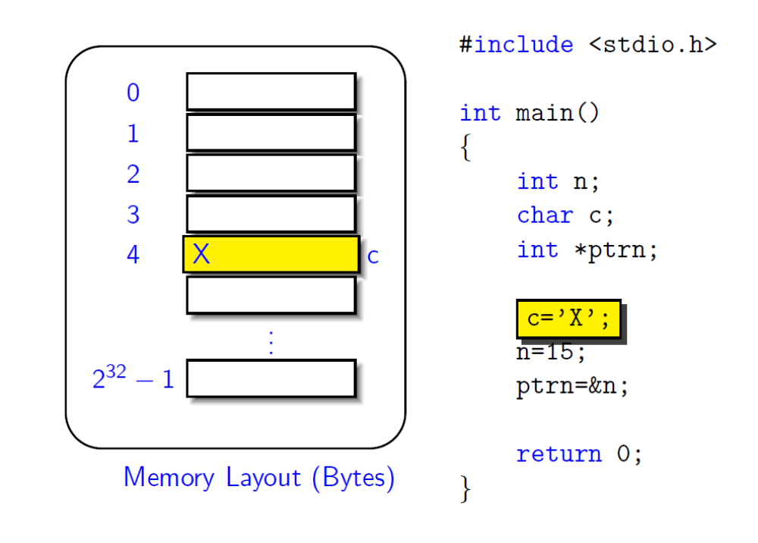

Slide 20
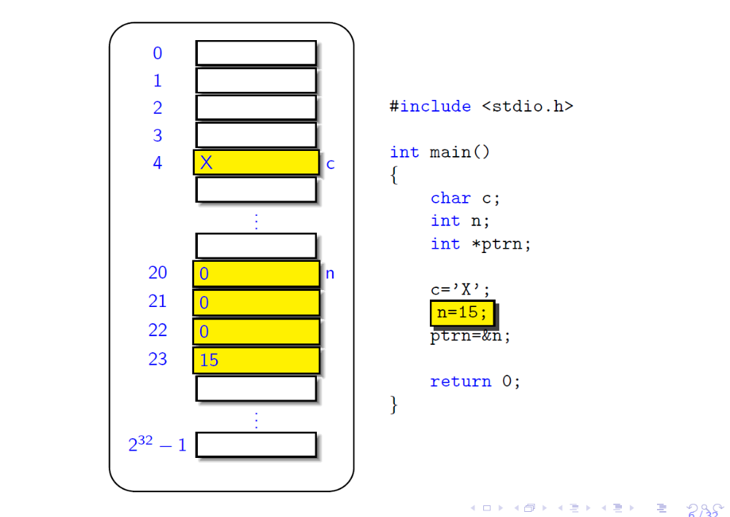

Slide 21
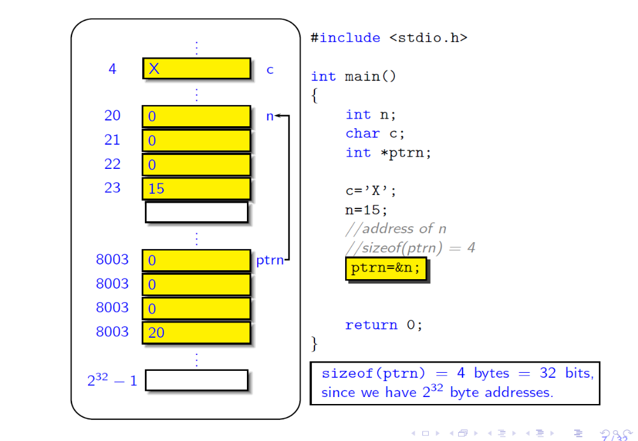

Slide 22
NULL Pointers
It is always a good practice to assign a NULL value to a pointer variable in case you do not have an exact address to be assigned. This is done at the time of variable declaration. A pointer that is assigned NULL is called a null pointer.
The NULL pointer is a constant with a value of zero defined in several standard libraries. Consider the following program −

Slide 23
#include <stdio.h>
int main () {
int *ptr = NULL;
printf("The value of ptr is : %x\n", ptr );
return 0;
}
Output
The value of ptr is 0

Slide 24
Pointers Arithmetic Operations in C
Pointer variables are used to store address of variables. Address of any variable is an unsigned integer value i.e., it is a numerical value. So we can perform arithmetic operations on pointer values. But when we perform arithmetic operations on pointer variable, result depends on the amount of memory required by the variable to which the pointer is pointing.
In c programming language, we can perform the following arithmetic operations on pointers...
  Addition
  Subtraction
  Increment
  Decrement
  Comparison

Slide 25
Addition and Subtraction Operation on Pointer
In C programming language, the addition operation on pointer variables is calculated using the following formula...
  AddressAtPointer + ( NumberToBeAdd * BytesOfMemoryRequiredByDatatype )
the subtraction operation on pointer variables is calculated using the following formula...
  AddressAtPointer - ( NumberToBeAdd * BytesOfMemoryRequiredByDatatype )

Slide 26
Pointers Arithmetic Operations in C
Pointer variables are used to store address of variables. Address of any variable is an unsigned integer value i.e., it is a numerical value. So we can perform arithmetic operations on pointer values. But when we perform arithmetic operations on pointer variable, result depends on the amount of memory required by the variable to which the pointer is pointing.
In c programming language, we can perform the following arithmetic operations on pointers...
  Addition
  Subtraction
  Increment
  Decrement
  Comparison

Slide 27
Addition and Subtraction Operation on Pointer
In C programming language, the addition operation on pointer variables is calculated using the following formula...
  AddressAtPointer + ( NumberToBeAdd * BytesOfMemoryRequiredByDatatype )
the subtraction operation on pointer variables is calculated using the following formula...
  AddressAtPointer - ( NumberToBeAdd * BytesOfMemoryRequiredByDatatype )

Slide 28
Addition Example
void main()
{
int a, *intPtr ;
float b, *floatPtr ;
double c, *doublePtr ;
clrscr() ;
intPtr = &a ; // Asume address of a is 1000
floatPtr = &b ; // Asume address of b is 2000
doublePtr = &c ; // Asume address of c is 3000
intPtr = intPtr + 3 ; // intPtr = 1000 + ( 3 * 4 )
floatPtr = floatPtr + 2 ; // floatPtr = 2000 + ( 2 * 4 )
doublePtr = doublePtr + 5 ; // doublePtr = 3000 + ( 5 * 8 )
printf("intPtr value : %u\n", intPtr) ;
printf("floatPtr value : %u\n", floatPtr) ;
printf("doublePtr value : %u", doublePtr) ;
getch() ;
}
intPtr value : 1012
floatPtr value : 2008
doublePtr value : 3040

Slide 29
Subtraction Example
void main()
{
int a, *intPtr ;
float b, *floatPtr ;
double c, *doublePtr ;
clrscr() ;
intPtr = &a ; // Asume address of a is 1000
floatPtr = &b ; // Asume address of b is 2000
doublePtr = &c ; // Asume address of c is 3000
intPtr = intPtr - 3 ; // intPtr = 1000 - ( 3 * 4 )
floatPtr = floatPtr - 2 ; // floatPtr = 2000 - ( 2 * 4 )
doublePtr = doublePtr - 5 ; // doublePtr = 3000 - ( 5 * 8 )
printf("intPtr value : %u\n", intPtr) ;
printf("floatPtr value : %u\n", floatPtr) ;
printf("doublePtr value : %u", doublePtr) ;
getch() ;
}
intPtr value : 988
floatPtr value : 1992
doublePtr value : 2960

Slide 30
Increment & Decrement Operation on Pointer
The increment operation on pointer variable is calculated as follows...
  AddressAtPointer + NumberOfBytesRequiresByDatatype
The decrement operation on pointer variable is calculated as follows...
  AddressAtPointer - NumberOfBytesRequiresByDatatype

Slide 31
Increment Example
void main()
{
int a, *intPtr ;
float b, *floatPtr ;
double c, *doublePtr ;
clrscr() ;
intPtr = &a ; // Asume address of a is 1000
floatPtr = &b ; // Asume address of b is 2000
doublePtr = &c ; // Asume address of c is 3000
intPtr++ ; // intPtr = 1000 + 4
floatPtr++ ; // floatPtr = 2000 + 4
doublePtr++ ; // doublePtr = 3000 + 8
printf("intPtr value : %u\n", intPtr) ;
printf("floatPtr value : %u\n", floatPtr) ;
printf("doublePtr value : %u", doublePtr) ;
getch() ;
}
intPtr value : 1004
floatPtr value : 2004
doublePtr value : 3008

Slide 32
Decrement Example
void main()
{
int a, *intPtr ;
float b, *floatPtr ;
double c, *doublePtr ;
clrscr() ;
intPtr = &a ; // Asume address of a is 1000
floatPtr = &b ; // Asume address of b is 2000
doublePtr = &c ; // Asume address of c is 3000
intPtr++ ; // intPtr = 1000 - 4
floatPtr++ ; // floatPtr = 2000 - 4
doublePtr++ ; // doublePtr = 3000 - 8
printf("intPtr value : %u\n", intPtr) ;
printf("floatPtr value : %u\n", floatPtr) ;
printf("doublePtr value : %u", doublePtr) ;
getch() ;
}
intPtr value : 996
floatPtr value : 1996
doublePtr value : 2992

Slide 33
Comparison of Pointers
The comparison operation is perform between the pointers of same datatype only.
In c programming language, we can use all comparison operators (relational operators) with pointers.
We can't perform multiplication and division operations on pointers.

Slide 34
Consider two pointers ptr1 and ptr2 which point to the same type of data.
  <datatype> *ptr1, *ptr2;
Adding two pointers together is not allowed!
ptr1 - ptr 2 is allowed, as long as they are pointing to elements of the same array. The result is
ptr1 - ptr2
sizeof(datatype)
In other settings, this operation is undefined (may or may not give the correct answer).

Slide 35
If we can subtract a pointer from another, all the relational operations can be supported!
Logical Operations on Pointers
  ptr1 > ptr2 is the same as ptr1 - ptr2 > 0,
  ptr1 = ptr2 is the same as ptr1 - ptr2 = 0,
  ptr1 < ptr2 is the same as ptr1 - ptr2 < 0,

Slide 36
Pointers to Pointers in C
In c programming language, we have pointers to store the address of variables of any datatype. A pointer variable can store the address of normal variable.
C programming language also provides pointer variable to store the address of another pointer variable. This type of pointer variable is called as pointer to pointer variable.
Sometimes we also call it as double pointer. We use the following syntax for creating pointer to pointer…
  datatype **pointerName ;

Slide 37
Example
  int **ptr;
Here, ptr is an integer pointer variable that stores the address of another integer pointer variable but does not stores the normal integer variable address.
Points to be Remembered
  To store the address of normal variable we use single pointer variable
  To store the address of single pointer variable we use double pointer variable
  To store the address of double pointer variable we use triple pointer variable
  Similarly the same for remaining pointer variables also…

Slide 38
Example
void main()
{
int a ;
int *ptr1 ;
int **ptr2 ;
int ***ptr3 ;
clrscr() ;
ptr1 = &x ;
ptr2 = &ptr1 ;
ptr3 = &ptr2 ;
printf(“Address of ‘x’ = %u\n”, ptr1) ;
printf(“Address of ‘ptr1’ = %u\n”, ptr2) ;
printf(“Address of ‘ptr2’ = %u\n”, ptr3) ;
getch() ;
}

Slide 39
Pointers For Functions in C
In c programming language, there are two ways to pass parameters to functions. They are as follows...
  Sending the values of the arguments (Call by Value)
  Sending the addresses of the arguments (Call By Reference)

Slide 40
In the first method the ‘value’ of each actual arguments in the calling function is copied into corresponding formal argument of the called function.
With this method, changes made to the formal arguments in the called function have no effect on the values of the actual arguments in the calling function.

Slide 41
Example
main()
{
int a = 10;
int b = 20;
swapv(a,b)
printf(“\na=%d”, a);
printf(“\nb=%d”, b);
}
swapv(int x, int y)
{
int t;
t=x;
x=y;
y=t;
printf(“\n x=%d”, x);
printf(“\n y=%d”, y);
}
Output:
x=20
y=10
a=10
b=20

Slide 42
The second method (call by reference) the addresses of actual arguments in the calling function are copied into formal arguments of the called function.
Means by using the formal arguments in the called function we can make changes in the actual arguments of the calling function

Slide 43
Example
main()
{
int a = 10;
int b = 20;
swapr(&a, &b)
printf (“\n a = %d”, a);
printf (“\n b = %d”, b);
}
swapr(int *x, int *y)
{
int t;
t = *x;
*x = *y;
*y = t;
}
Output
a = 20
b = 10

Slide 44
Using ‘call by reference’ intelligently we can make a function return more than one value at a time, which is not possible ordinarily.
Example

Slide 45
Example
main()
{
int radius;
float area, perimeter;
printf(“\n Enter radius of a circle”);
scanf(“%d”, &radius);
areapri(radius, &area, &perimeter);
printf(“Area=%f”, area);
printf(“\nPerimeter = %f”, perimeter);
}
areaperi(int r, float *a, float *p)
{
*a=3.14*r*r;
*p=2*3.14*r;
}
Output
Enter radius of a circle 5
Area = 78.500000
Perimeter = 31.400000
Notes:
Here, we are making a mixed call, in the sense, we are passing the value of radius but, addresses of area and perimeter, And since we are passing the addresses, any changes that we make in values stored at addresses, any changes that we make in values stored at addresses contained in variables a and p, would make the change effective even in main(). That is why when the control returns from the function areaperi(). We are able to output the values of area and perimeter.

Slide 46
Exercise
main()
{
int i=-5; j=-2;
junk(i, &j);
printf(“\n i=%d j=%d”, i,j);
}
junk(int i, int *j)
{
i=i*i;
*j=(*j)*(*j);
}
Output
i=-5 j=4

Slide 47
main()
{
char c, *cc;
int i;
long l;
float f;
c = ‘Z’;
i = 15;
l = 77777;
f = 3.14;
cc = &c;
printf(“\n c = %c cc = %u”, *cc, cc);
cc=&i;
printf(“\n i = %d cc = %u”, *cc, cc);
cc=&l;
printf(“\n l = %ld cc = %u”, *cc, cc);
cc=&f;
printf(“\n f = %f cc = %u”, *cc, cc);
}

Slide 48
main()
{
int a, *b, **c, ***d, ****e;
a = 10;
b = &a;
c = &b;
d = &c;
e = &d;
printf(“\n a=%d b=%u c=%u d=%u e=%u”, a,b,c,d,e);
printf(“\n %d %d %d, a, a+*b, **c+***d+****e);
}

Slide 49
main()
{
char *c = 4000;
int *i = 4000;
long *l = 4000;
float *f = 4000;
double *d = 4000;
printf("\n c=%u, c+1=%u", c,c+1);
printf("\n i=%u, i+1=%u", i,i+1);
printf("\n l=%u, l+1=%u", l,l+1);
printf("\n f=%u, f+1=%u", f,i+1);
printf("\n d=%u, d+1=%u", d,d+1);
}

Slide 50
Write a program in C to add two numbers using pointers
Write a program in C to add numbers using call by reference
Write a program in C to find the maximum number between two numbers using a pointer

